Slide 1
E-Disposer
Eco-friendly option for disposing e-Waste
13-Sanket Dhumal
56-Sachin Pal

Slide 2
Problem Statement
In the 20th Century, the information and communication revolution has brought enormous changes in the way we organize our lives, our economies, industries and institution.
At the same time, these have led to manifold problems including the problem of massive amount of hazardous waste and other wastes generated from electric products.
It constitutes a serious challenge to the modern societies and require coordinated effects to address it for achieving sustainable development.

Slide 3
Statistics
Out of total E-Waste volume in India
Television - 68%
Desktop,Server -27%
Imports - 2%
Mobile - 1%
Despite 23 units currently registered with Govt. of India, Ministry of Environment and Forest / Central Pollution Control Board, as E-Waste recyclers / preprocessors the entire recycling process more or less still exists in the unorganized sector.

Slide 4
The need of the project
Such predictions highlight the urgent need to address the problem of E-Waste in developing countries like India where the collection and management of E-Waste and the recycling process is yet to be properly regulated
It may cause rising environmental damage and health problems of E-Waste recycling if left to the vagaries of the informal sector

Slide 5
Introduction
To help curb this e-waste generation problem we are creating a website which will help the e-waste to be disposed off properly.
Using this website the user can post different amount of e-waste it has and can also generate money for the same.

Slide 6
The app contains following modules
User Details
E-waste quantity Details
Money calculator
Drop-off locations
Pickup-service

Slide 7
System Overview
Software Requirement
CodeIgnitor
Bootstrap
Mobile App
Website
Hardware Requirement
Processor- Dual Core
Hard disk- 50GB
Memory – 1GB RAM

Slide 8
Advantages
Using this website the user can
Post the e-waste like mobile, desktop,
air-conditioner etc online.
He can calculate the price of the waste he has with online e-waste calculator.
He can drop the e-waste at recycling centers or a pickup can be arranged.
He can decide which dealer offers him highest price of the garbage.

Slide 9
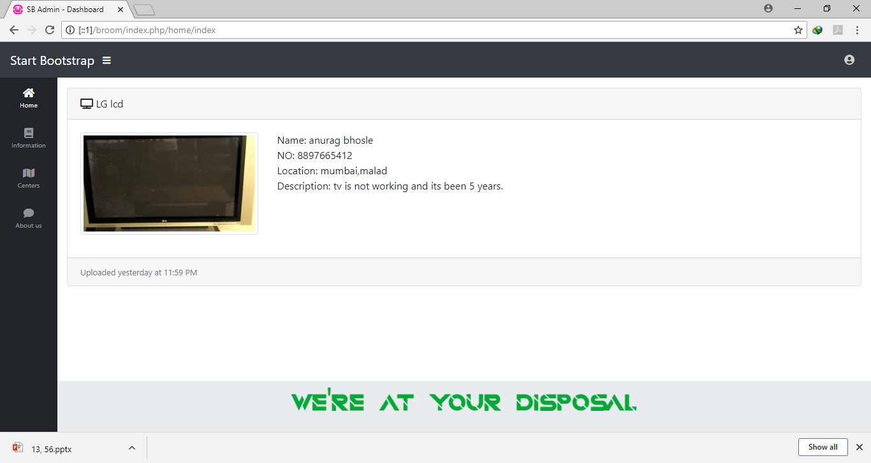
Screenshot

Slide 10
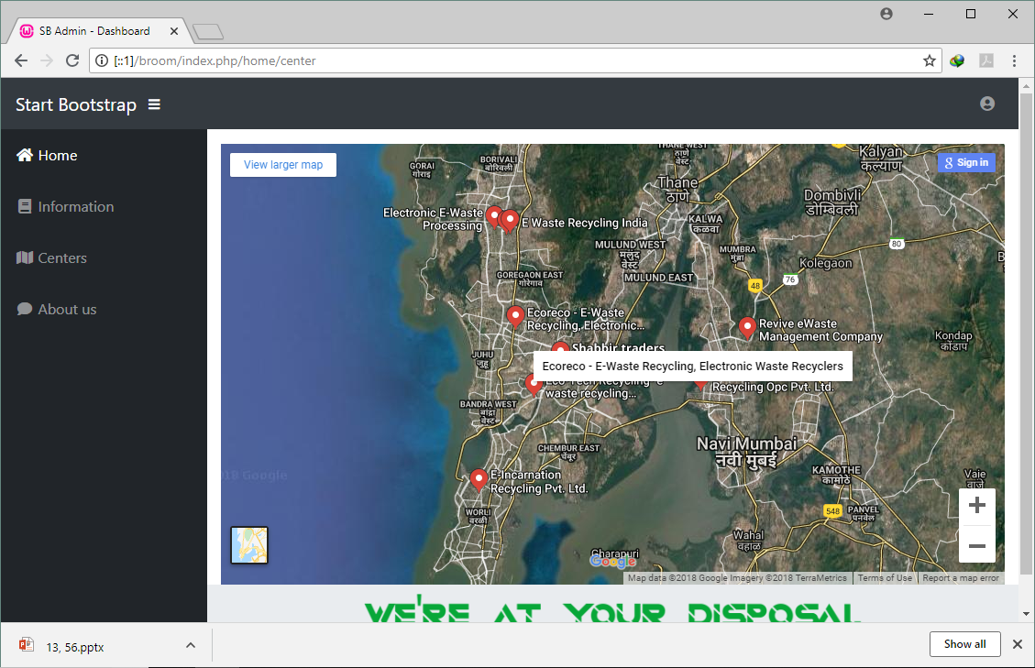

Slide 11
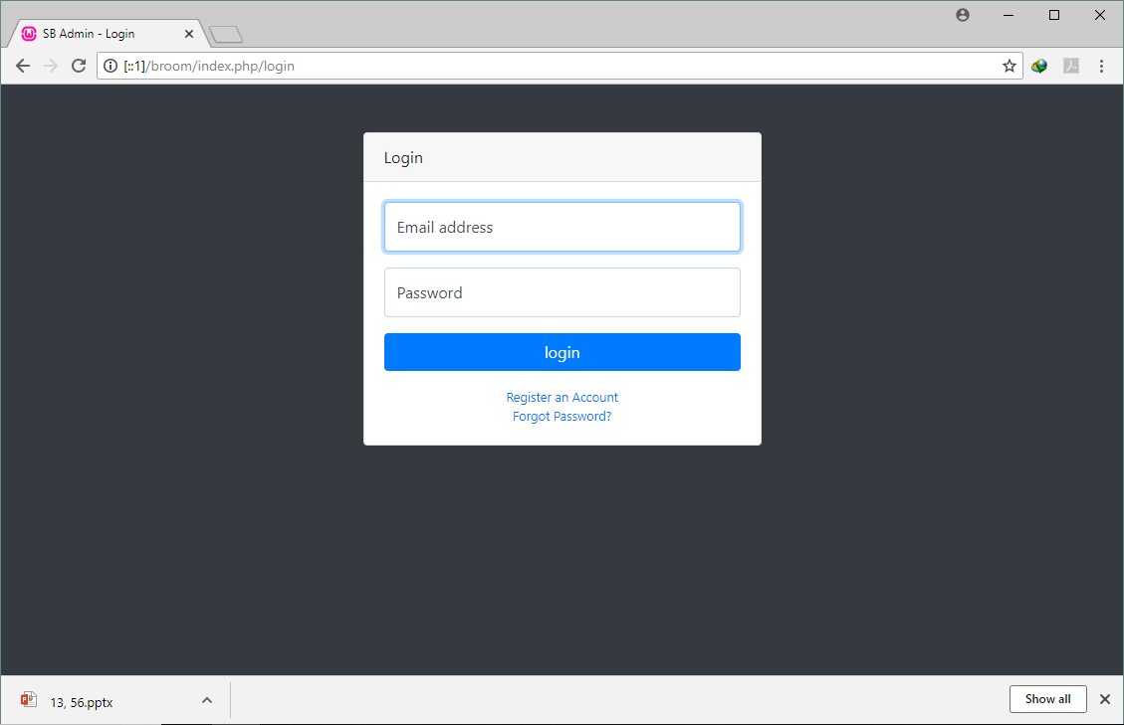

Slide 12
